Slide 1
Zero Bank Capstone Project
Presented by ELAKURTHI SAI SPOORTHI

Slide 2
agenda
INTRODUCTION
OBJECTIVE
ABOUT THE APPLICATION
PROJECT STRUCTURE
TESTING PROCESS
MAJOR FUNCTIONALITIES AUTOMATED
SAMPLE FILES
DEFECTS FOUND
SCREENSHOTS OF TEST CASES,REPORTS
CONCLUSION

Slide 3
Myself Elakurthi Sai Spoorthi. I am from Nalgonda District, Telangana. I have completed my Bachelor of Technology at CVR college of Engineering ,Hyderabad in the stream of Computer Science and Engineering.
introduction

Slide 4
Objective Automate key functionalities of the Zero Bank application (http://zero.webappsecurity.com/) using Selenium and Python. This project will cover functional testing of login, account management, fund transfers, and payment systems.

Slide 5
About the application Zero Bank automation testing validates key online banking features using Selenium WebDriver, Cucumber BDD, and Maven. Main modules include Login/Logout, Account Summary, Funds Transfer, Bill Payment, and Transaction History. It verifies account types like Checking, Savings, Credit Card, and Loan. Tests ensure smooth user experience in login, fund transfers, bill payments, and security settings. Automation is executed using the TestNG framework.

Slide 6
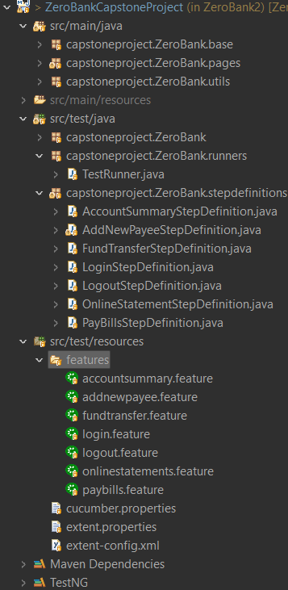
Project structure

Slide 7
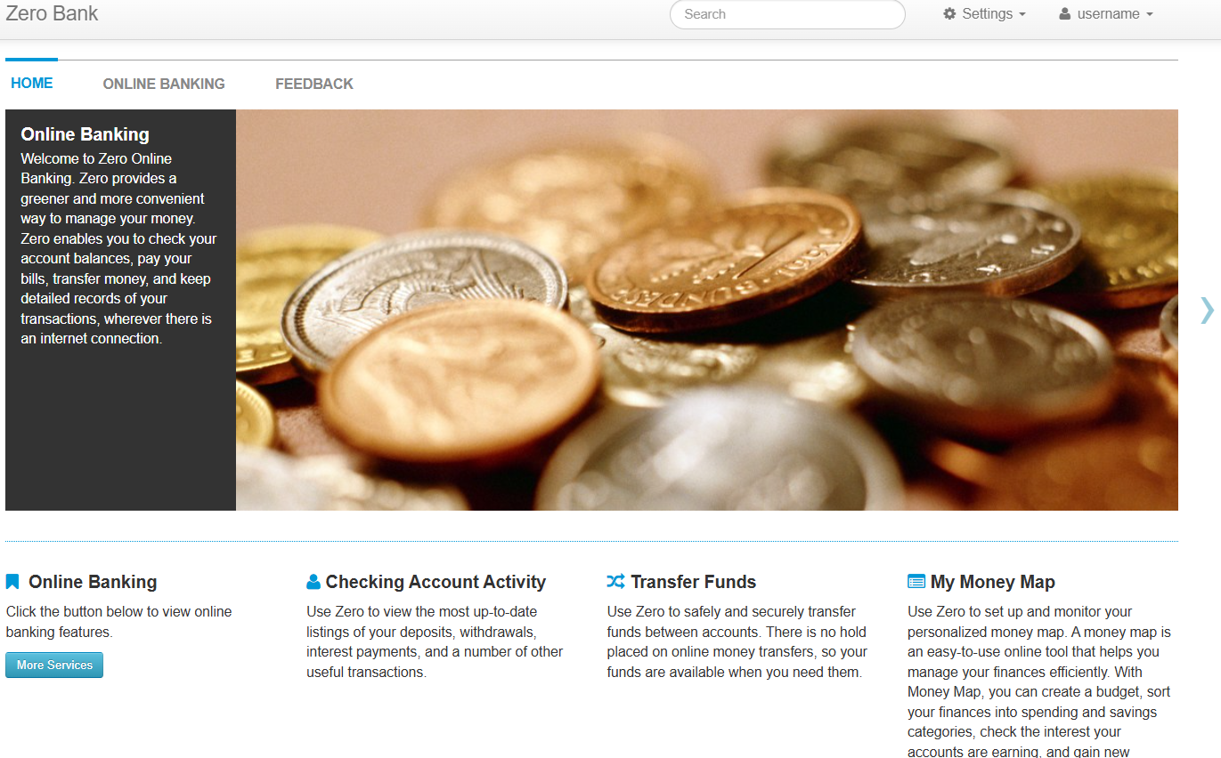
Application Website

Slide 8
Testing process Testing Process Requirement Analysis Test Planning & Strategy Test Case Development Test Environment Setup Test Execution Defect Reporting & Debugging Test Closure & Reporting

Slide 9
Major functionalities automated User Authentication Automates login & logout flows Validates behavior with invalid credentials Account Summary Verifies account types (Checking, Savings, etc.) Confirms account balances Funds Transfer Automates transferring funds between accounts Checks for successful confirmation messages Bill Payments Adds and pays bills to payees Validates payment confirmation Account Activity / Search Searches transaction history Validates filters and results Error Handling Tests invalid inputs and system responses Ensures user-friendly error messages

Slide 10
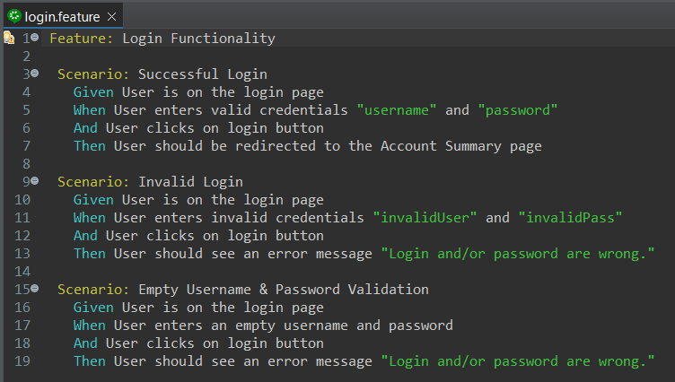
Sample feature files Login.Feature:

Slide 11
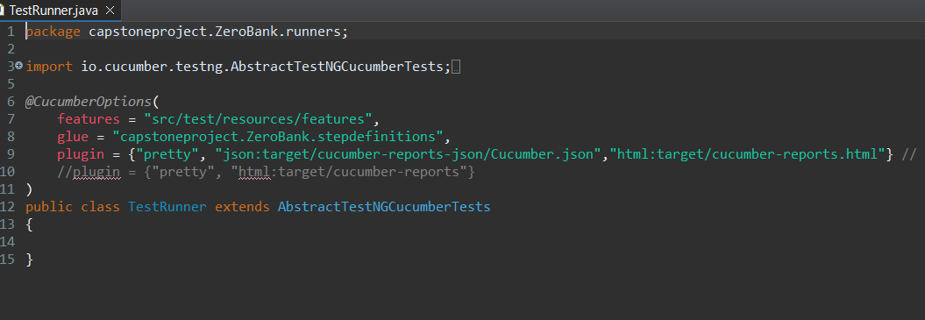
Test Runner TestRunner.java:

Slide 12
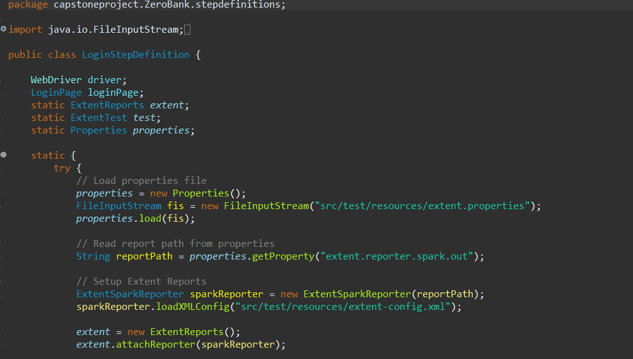
Sample Step Definition FIle Login.java:

Slide 13
Defects found * A cipher mismatch occurs when the browser and server can't agree on a common SSL/TLS encryption algorithm, causing errors like "ERR_SSL_VERSION_OR_CIPHER_MISMATCH". In the Zero Bank app, this can result in a blank or error screen after login. * To handle it, we use driver.navigate().back(); in Selenium to return to the functional page and continue the test smoothly. * Due to performance testing it fails testcases sometimes. * During fund transfer, the application does not update the account balance after the transaction. Additionally, it fails to display an appropriate error message when there are insufficient funds in the account.

Slide 14
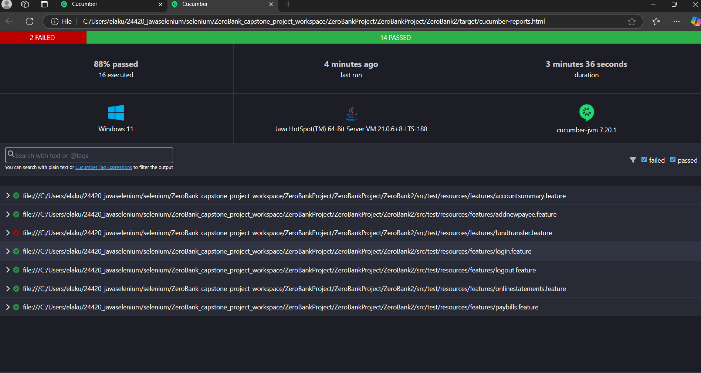
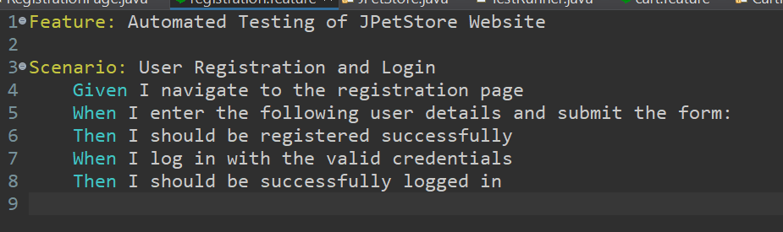
SCREENSHOTS OF TEST CASES, REPORTS

Slide 15
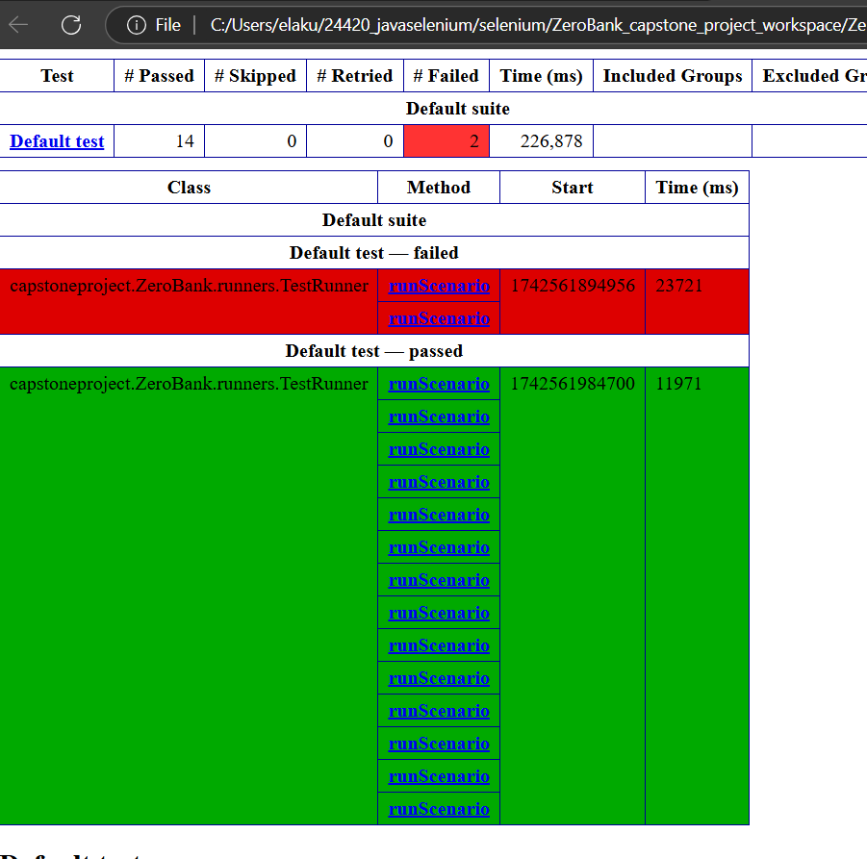
SCREENSHOTS OF TEST CASES, REPORTS

Slide 16
Conclusion: Using TestNG as a runner for Cucumber tests enhances test automation by providing structured execution, better reporting, and parallel testing capabilities. It simplifies test management through annotations, data-driven testing, and dependency handling, making it a powerful framework for large-scale test automation. With seamless integration into CI/CD pipelines and support for cross-browser testing, TestNG ensures efficient and reliable test execution. Its advanced features like retry mechanisms, assertions, and listeners improve test stability and maintainability. Overall, combining TestNG with Cucumber offers a robust solution for behavior-driven development and automation testing.

Slide 17
Thank you

